Slide 1
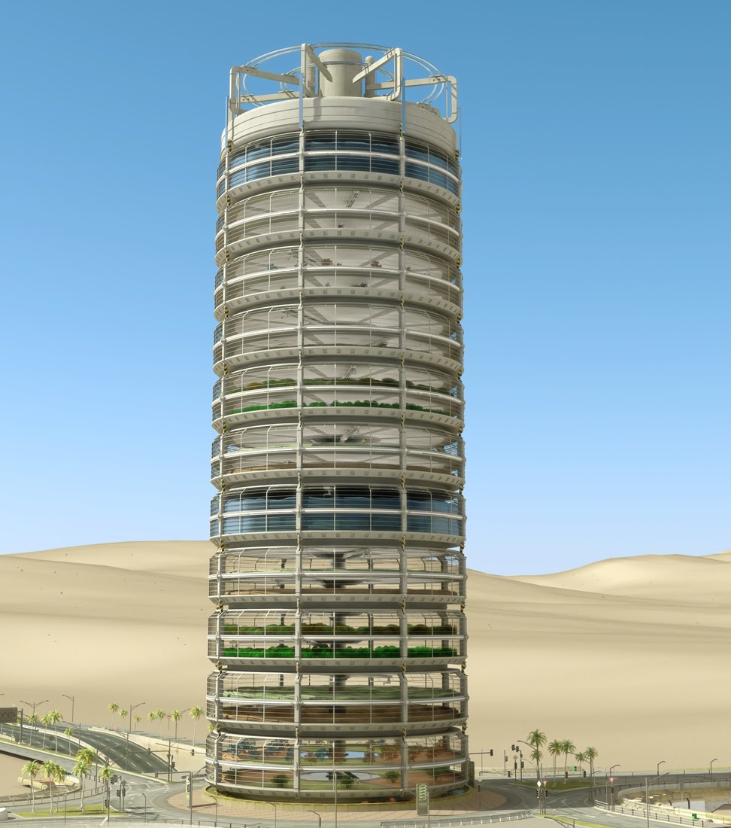
OVERVIEW
DENNIS PAN 12/16/2011
THE ORGANIZATION GREENBAY CURRENTLY DOES NOT EXIST. PERSONAL HOBBY ONLY.
Notes:
PICTURE:
http://3.bp.blogspot.com/_BxR2Wc1r2u8/Swa_vbo5U3I/AAAAAAAAAEg/jOVgFABA8TI/s1600/vf_old_BK_0096b.jpg

Slide 2
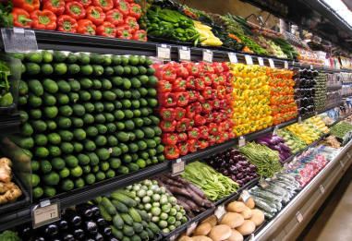
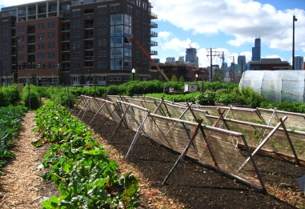
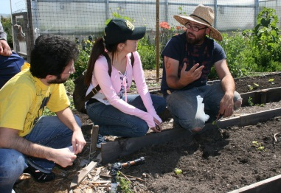
MISSION
DENNIS PAN 12/16/2011
BUILD AT LEAST 3 VERTICAL FARMS IN THE SF BAY AREA BY THE END OF EACH YEAR
BUILD URBAN VEGETABLE FARMS TO SUPPLY BAY AREA MARKETS WITH HIGH QUALITY PRODUCE
PROVIDE QUALITY URBAN AGRICULTURE JOBS TO 1000 COLLEGE GRADUATES
PROVIDE SCHOLARSHIPS TO A MAXIMUM OF 1000 UNIVERSITY STUDENTS MAJOR IN AGRICULTURAL SCIENCE AND BIOLOGY
Notes:
Supermarket picture:
http://4.bp.blogspot.com/-6azWaDM3K24/TVh5RUsYqJI/AAAAAAAAA9o/1hkXsiIGiLA/s1600/Whole%2BFoods%2BReno%252C%2BNV.JPG.jpeg
Urban Farm picture:
http://upload.wikimedia.org/wikipedia/commons/3/3d/New_crops-Chicago_urban_farm.jpg
Picture of 3 people in an urban farm:
http://lh4.ggpht.com/-X0zMjzOGcYg/S_VzIIdOHfI/AAAAAAAAAHw/Q2x5fH0Siu4/Veggielution%252520026.jpg

Slide 3
FUND COLLECTION
DENNIS PAN 12/16/2011
TO GET THE FUND WE NEED TO FULFILL OUR MISSION, WE USE THE LOTTERY SYSTEM:
GET AT LEAST 20 MILLION MEMBERS ON OUR ONLINE NETWORK “GREENBAY”
TO OBTAIN AT LEAST $1 BILLION A YEAR, SELL $200 LOTTERIES TO AT LEAST 5 MILLION “GREENBAY” MEMBERS EACH YEAR
EACH MEMBER ENTERING THE LOTTERY FOR A GIVEN YEAR HAS 1 IN 2000 CHANCE TO WIN $200,000
50% OF THE LOTTERY INCOME GOES TO PRIZE WINNERS, AND THE REST BE USED TO FULFILL OUR MISSION

Slide 4
UTILIZING FUND
DENNIS PAN 12/16/2011

Slide 5
OUTCOMES WE WANT
DENNIS PAN 12/16/2011
EACH YEAR BUILD 3 VERTICAL FARMS THAT CAN SUPPLY HEALTHY PRODUCE TO 20000 BAY AREA RESIDENTS ANNUALLY
WORK WITH BAY AREA COMMUNITIES TO ESTABLISH URBAN FARMS TO SUPPLY URBAN RESIDENTS WITH HEALTHY PRODUCE
FINANCIALLY SUPPORT 1000 UNIVERSITY STUDENTS ALL THE WAY TO GRADUATION
GOOD PAY, HEALTH INSURANCE, AND WORK EXPERIENCES TO 1000 COLLEGE GRADUATES WORKING ON OUR PROJECTS

Slide 6
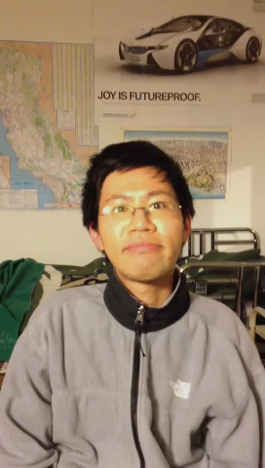
WORD FROM DENNIS
VIDEO

