Slide 1
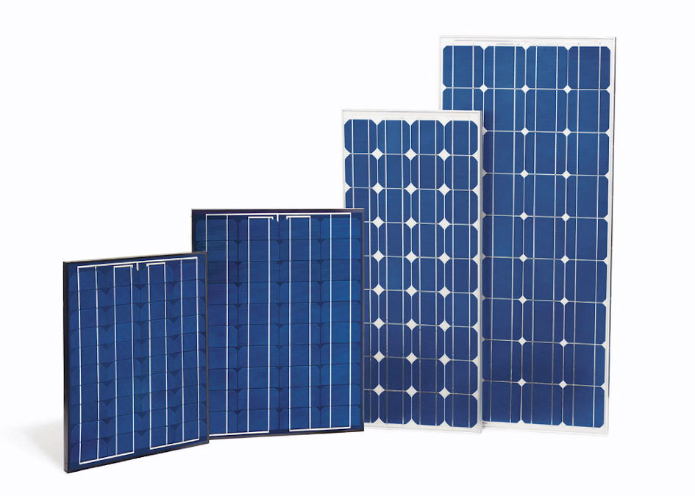
DENNIS PAN 9/14/2011
  OVERVIEW

Slide 2
DENNIS PAN 9/14/2011
  MISSION
  INSTALL PV SYSTEMS WITH A COMBINED CAPACITY OF 80MW IN CALIFORNIA BY THE END OF EACH YEAR
  PROVIDE QUALITY RENEWABLE ENERGY RELATED JOBS TO 1000 COLLEGE GRADUATES IN CALIFORNIA
  PROVIDE SCHOLARSHIPS TO A MAXIMUM OF 3000 UNIVERSITY STUDENTS IN CALIFORNIA
  INCREASE AWARENESS ON RENEWABLE ENERGY AMONG K-12 STUDENTS

Slide 3
DENNIS PAN 9/14/2011
  FUND COLLECTION
  TO GET THE FUND WE NEED TO FULFILL OUR MISSION, WE USE THE LOTTERY SYSTEM:
GET AT LEAST 20 MILLION MEMBERS ON OUR ONLINE NETWORK “CAL-SOLAR”
TO OBTAIN AT LEAST $1 BILLION A YEAR, SELL $200 LOTTERIES TO AT LEAST 5 MILLION “CAL-SOLAR” MEMBERS EACH YEAR
EACH MEMBER ENTERING THE LOTTERY FOR A GIVEN YEAR HAS 1 IN 2000 CHANCE TO WIN $200,000
50% OF THE LOTTERY INCOME GOES TO PRIZE WINNERS, AND THE REST BE USED TO FULFILL OUR MISSION

Slide 4
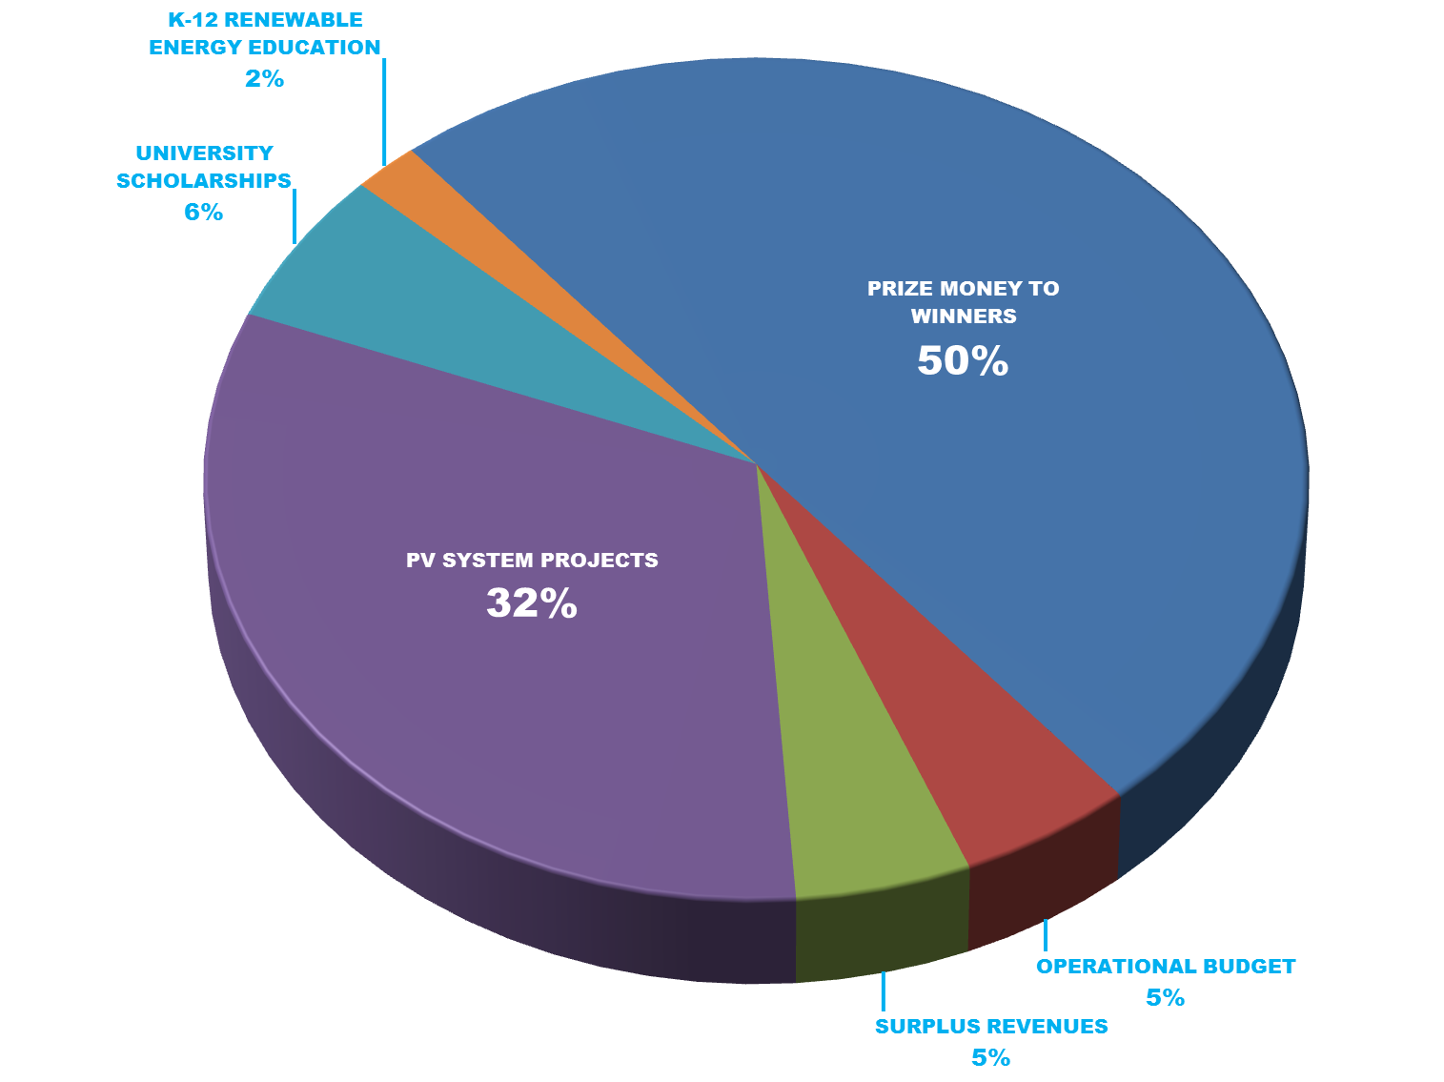
DENNIS PAN 9/14/2011
  UTILIZING FUND

Slide 5
DENNIS PAN 9/14/2011
  OUTCOMES WE WANT
  INSTALLING 80MW OF PV SYSTEMS/YEAR TO CUT CO2 EMISSIONS BY 124 MILLION LBS/YEAR
  NOTE: A 4KW PV SYSTEM ELIMINATES 6224 LB OF CO2^{[1]}, AND MULTIPLY THAT BY 20000 TO GET 124 MILLION LBS
  FINANCIALLY SUPPORT 3000 UNIVERSITY STUDENTS ALL THE WAY TO GRADUATION
  GOOD PAY, HEALTH INSURANCE, AND WORK EXPERIENCES TO 1000 COLLEGE GRADUATES WORKING ON OUR PV PROJECTS
  INSPIRE THOUSANDS OF K-12 STUDENTS IN CALIFORNIA TO BECOME ENVIRONMENTALLY CONSCIOUS LEADERS
[1] http://www.kyocerasolar.com/buy/pv_calculator.html

